Slide 1


Grantee financial resilience:
Building the Planning Muscle
April 9, 2021

Slide 2
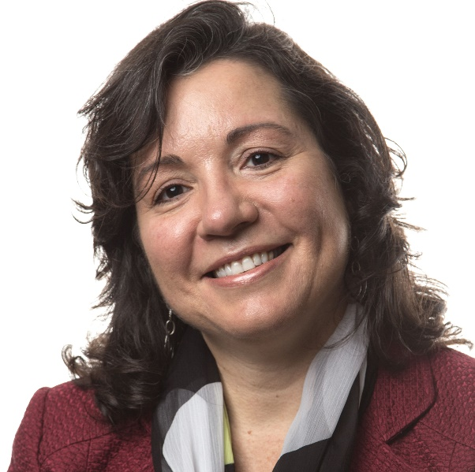
Today’s Presenter
HILDA POLANCO
Managing Director, BDO FMA

Slide 3








Meeting Norms: Participate Authentically
Respect each other - judge ideas, not people
Avoid multi-tasking
Be present & engaged
Be patient with tech
Expect confidentiality
Be prepared to use video
Expect active participation
Mute your microphone (unless you want to speak)

Slide 4



Applied Financial Analysis for Program Officers:
A THREE-PART SERIES
SESSION 1
Grantee Financial Resilience
A Framework
SESSION 2
Grantee Financial Resilience
Building the Planning Muscle
SESSION 3
Grantee Financial Resilience
Reframing Your Financial Due Diligence Process

Slide 5
Poll: Homework: How many months of LUNA did your chosen grantee have?
1 | 6 months or more
2 | Between 3 and 6 months
3 | Between 0 and 3 months
4 | My grantee had negative LUNA
5 | I was not able to complete the homework

Slide 6
Homework Review
ANSWER IN THE CHATBOX:
Did the LUNA amount you calculated align with your expectations based on what you know about the organization?

Slide 7
Financial Resilience

Slide 8
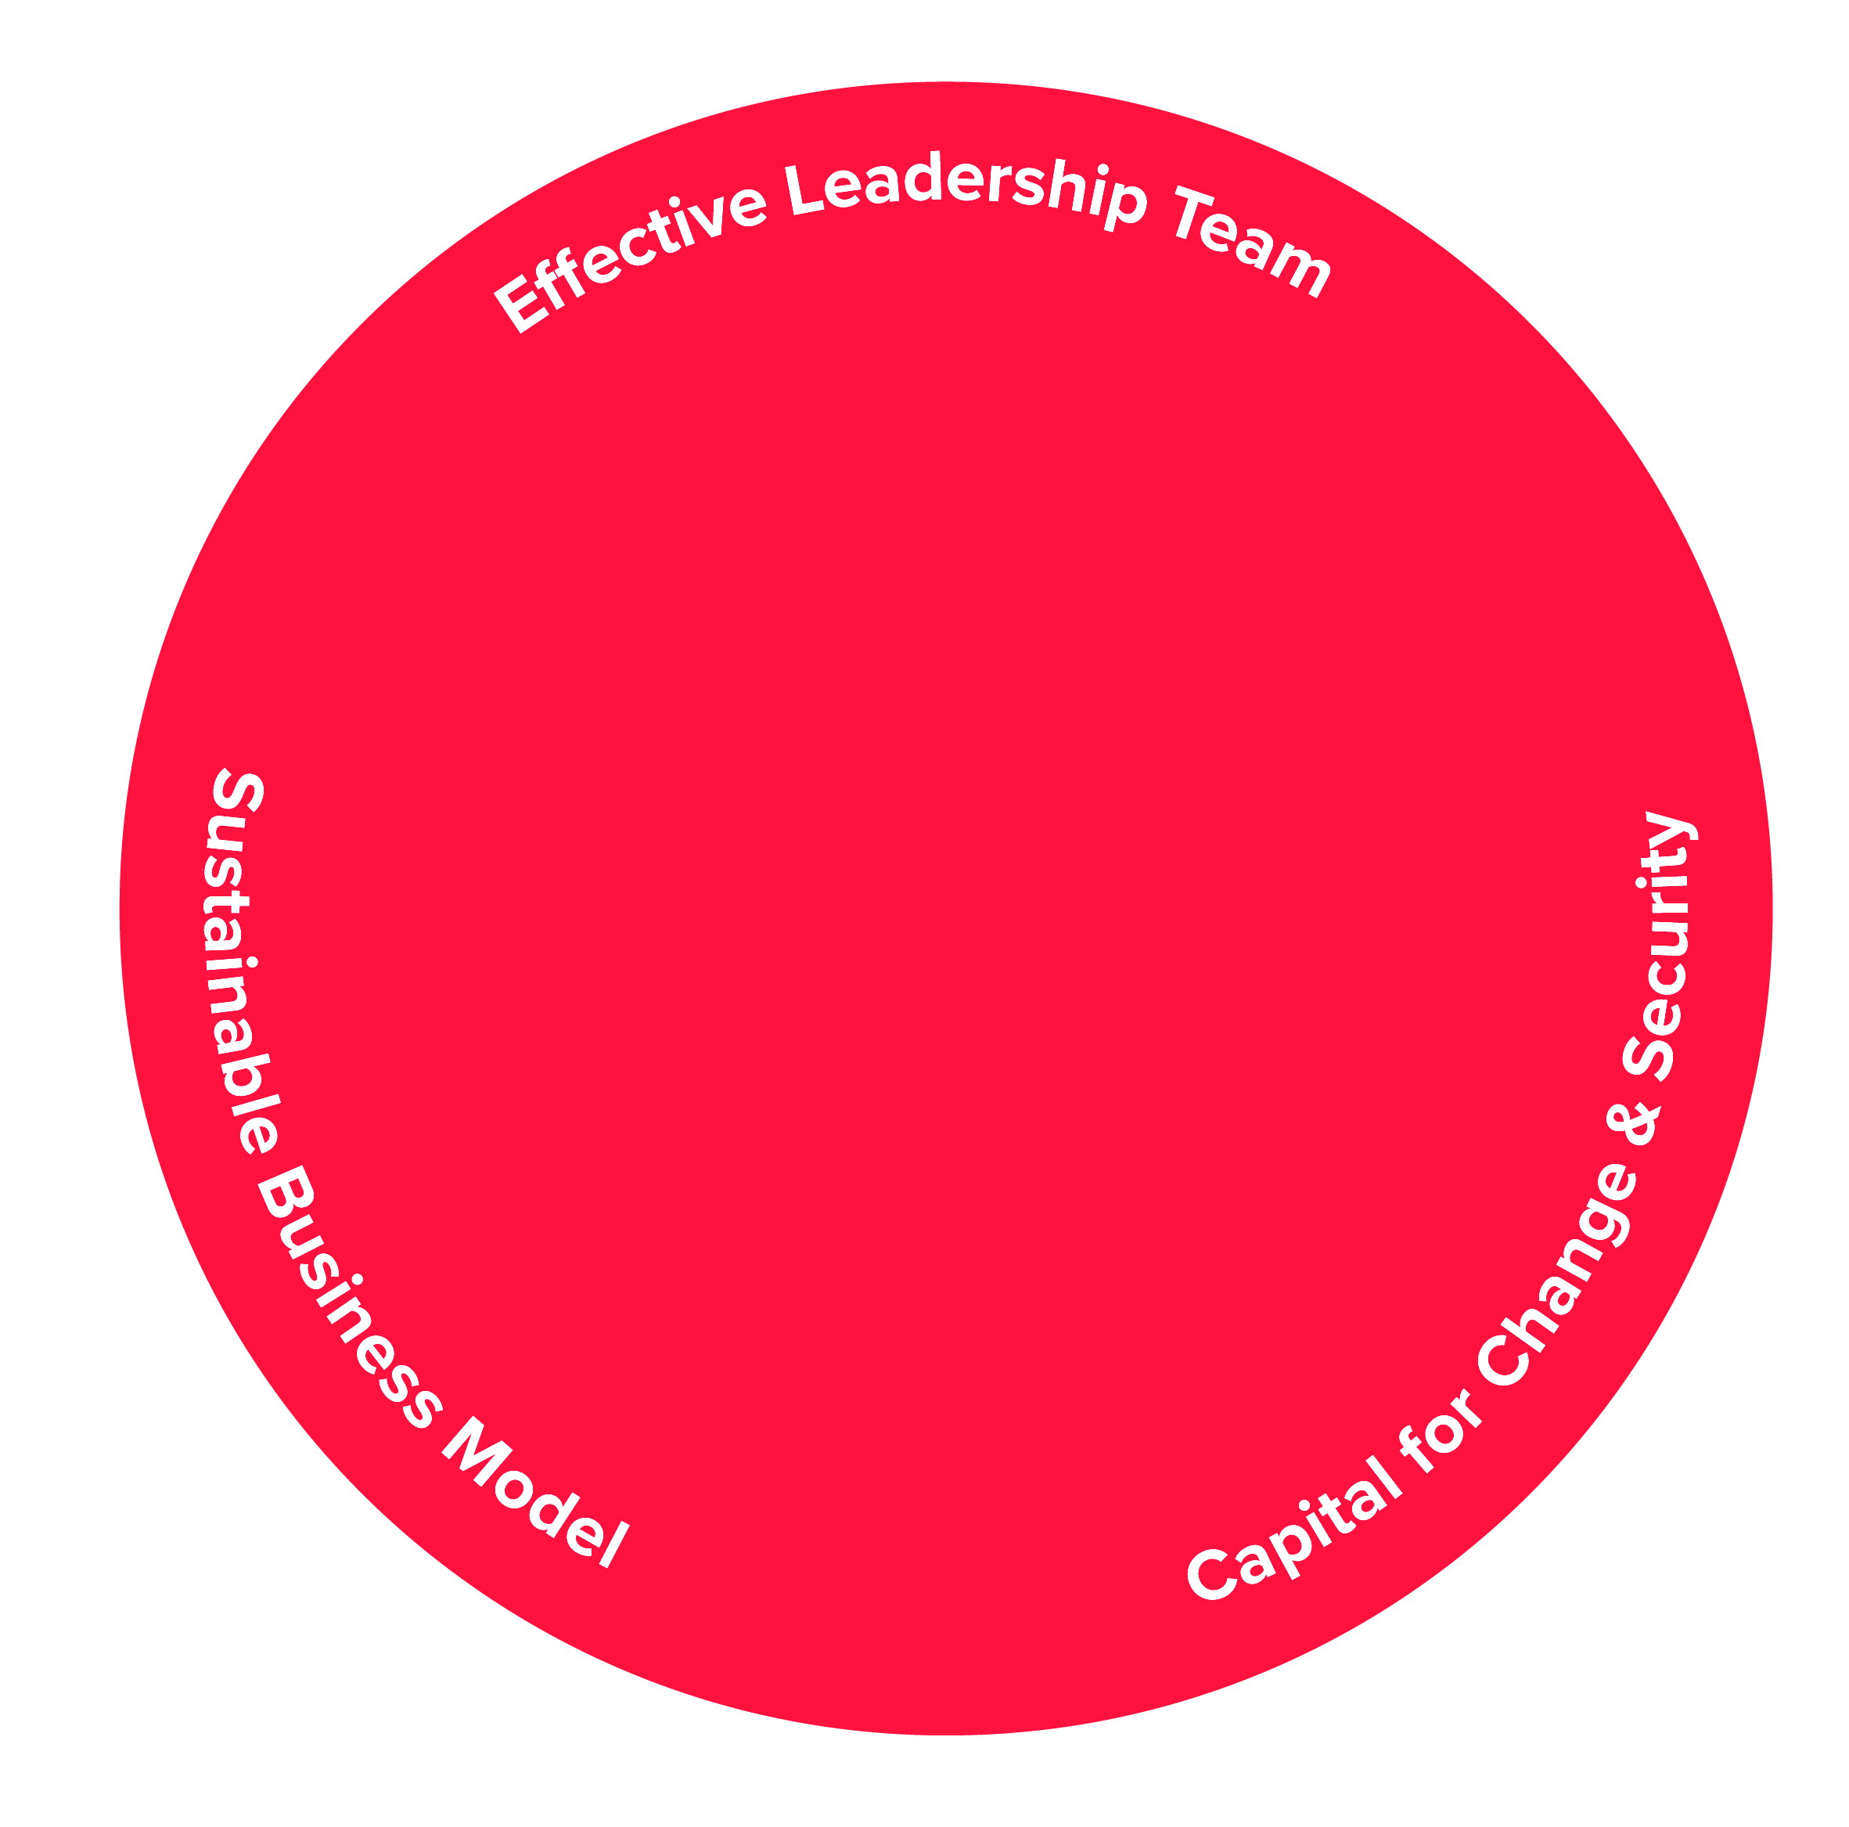
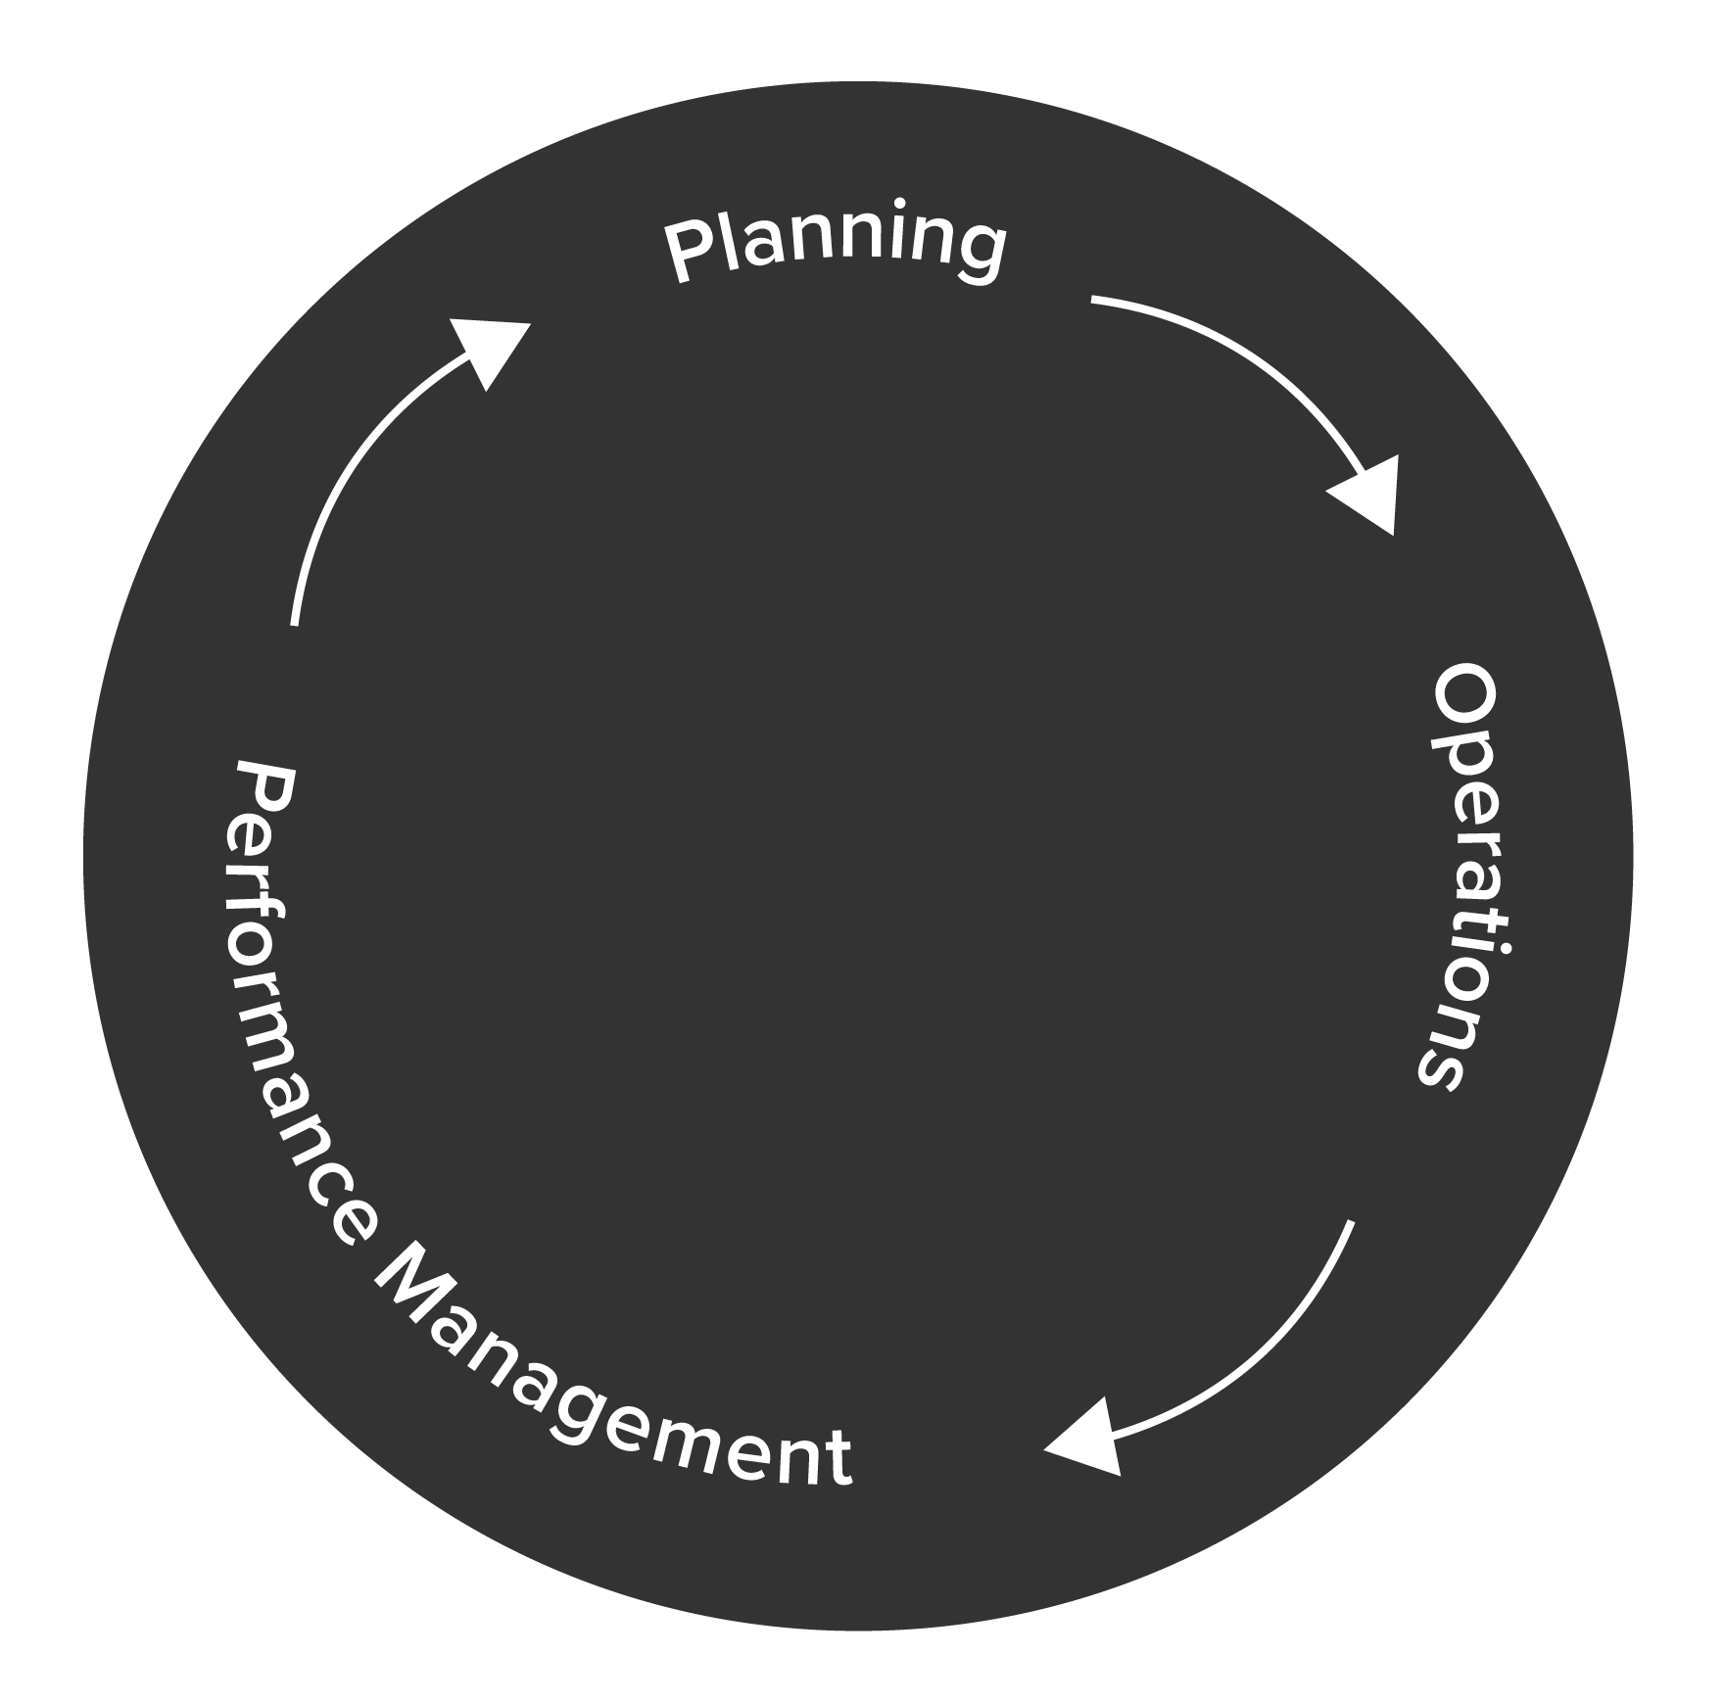
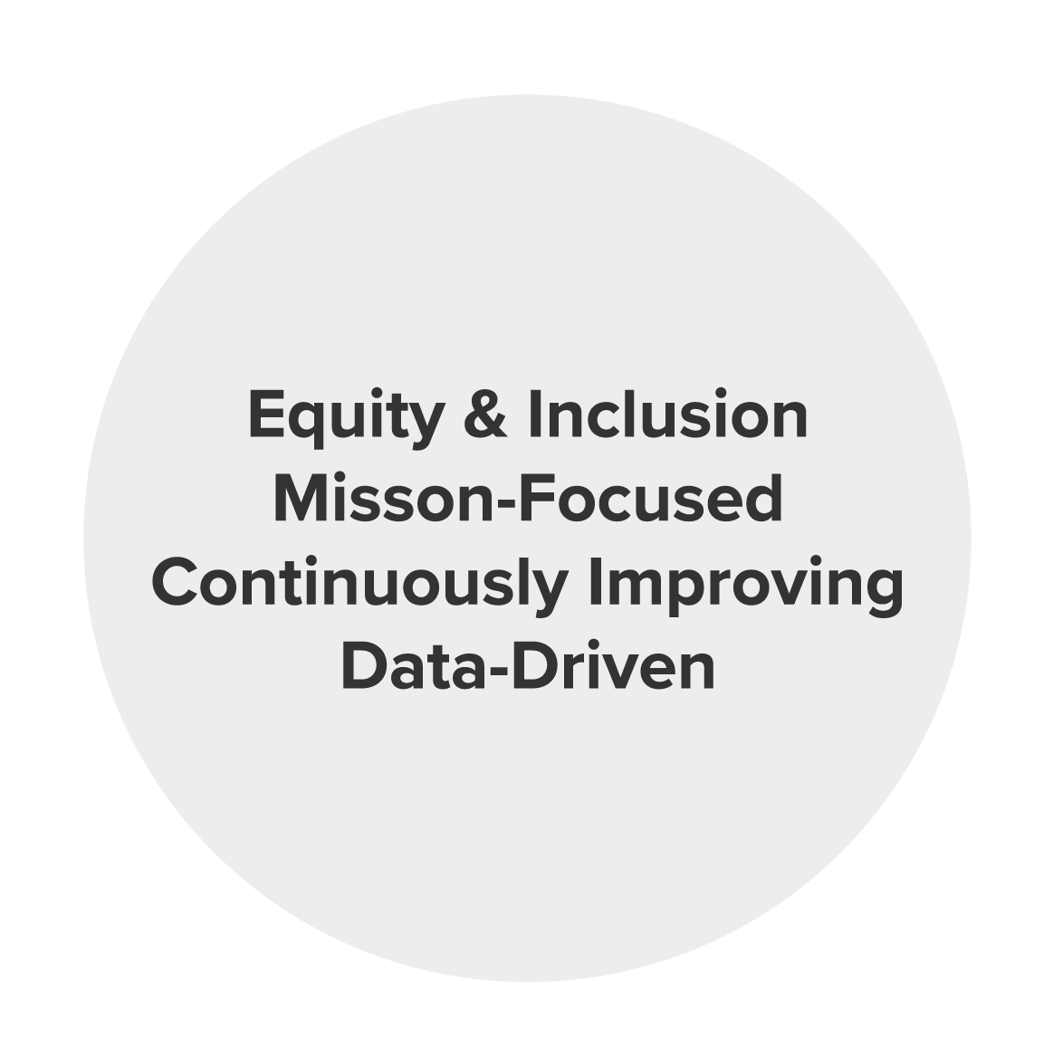
Financial Resilience
Values
Practices
Resources

Slide 9
Financial Resilience
Practices

Slide 10
Planning in Uncertain Times

Slide 11
Phases of Change
RESPOND
STABALIZE
REIMAGINE
Operations
Evaluation
Next Normal

Slide 12
Rubric for Understanding Phase of Change
Dimension
Organizational Attention
Planning Horizon
Program Delivery
Scenario Planning Focus
Financial Metrics
Funder Communication
Respond
Align operations to emerging context
3-6 months
Adapt delivery of services
Meet immediate client needs & update revenue assumptions
Months of cash
Match funding to context (release restrictions, extend timeline, support new needs)
Stabilize
Evaluate program and service delivery methods
6-18 months
Refine delivery of services
Address emerging community & refine operations
Reserves for current operating environment
Confirm renewed support
Reimagine
Rebalance mission and money in “next normal”
18-36 months
Rethink program, pricing, and business model
Accommodate expected societal shifts & funding landscape
Reserves for future operating environment
Seek long-term alignment and priorities
Notes:
Add to Schusterman training (with previous slide)

Slide 13
Scenario Planning

Slide 14
Poll: What are your biggest concerns regarding grantee financial health?
1 | Lack of adequate operating reserves
2 | Ability to navigate cash flow
3 | Diversification of revenue sources

Slide 15


Budgeting vs. Scenario Planning
BUDGET
Annual financial plan for an organization
A detailed projection of expenses and revenues based on prior year history
Used to prioritize available resources and manage performance
Scenario Plan
Alternate projection of financial results possibly across a different time horizon (e.g., 6-18 months)
A higher-level projection, based on assumptions about key drivers of revenues and expenses
Used to inform decisions in response to internal or external disruptions

Slide 16


Scenario Planning
Understand financial position
Identify
scenarios
Manage
cash flow
Establish Scenario Assumptions
Gather Data & Run the Numbers
Select Course of Action
Act,
Monitor
and Iterate
Notes:
Animate the four bubble at the bottom (top doesn’t need to be animated)

Slide 17



Understand Current Position:
The Balance Sheet
Cumulative result of an organization’s financial activity from its inception
Source of key financial health indicators such as liquidity, debt, and reserves
Shows how much financial flexibility an organization has

Slide 18



Building Scenarios: Key Questions
What are the external circumstances?
What will be the impact on our programs?
What will be the impact on financial health?

Slide 19




Programs: Identifying Options
Have or will any of our activities pause/stop?
Do we need to change the delivery method?
Are any activities increasing? Are new activities needed?
What is core to our mission and should be maintained?
Notes:
Would be good to have a breakout that talks about how have you seen your grantees identifying options? How have grantees been resilient? What success stories that you have?

Slide 20

Thoughts &
Questions

Slide 21

Breakout Activity
  Discuss the following questions with your group:
    How have your grantees been able to adapt and pivot over the past year?
    In which cases have you seen grantees not be able to successfully adapt?
  Designate a member of your team to document some of the key takeaways in the Padlet, using the link provided in the chat
Notes:
15-20 minutes

Slide 22
Break

Slide 23






Finance: Business Model
Revenue
Expense
Contributions
Personnel
BUSINESS
MODEL
Earned Revenue
Occupancy
Government
Goods & Services

Slide 24
Define Three High Level Scenarios
Define the levers that indicate which scenario you are in:
  External economic conditions
  Loss of a major grant
  Change in strategy among key funder(s)
  Programmatic shift
Best / Most Innovative
Moderate / Most Likely
Worst /
Plan B

Slide 25
Act, Monitor, and Iterate
  Define what prompts the implementation of the chosen scenario
  Define critical check points for the board once the scenario is implemented
  Determine roles and responsibilities for operationalizing the scenario plan
  Create an internal and external communication plan
Notes:
Talking points:
What are the unique variables?
What’s the timeframe in which you will need to make a decision?
How will the market tell us if we are in one scenario or the other?

Slide 26
Poll: What types of support are you providing or are planning to provide to your grantees?
1 | Converting restricted program grants to general operating
2 | Providing funds in support of the “reimagining” phase
3 | Advancing payments on multi-year commitments
4 | Low or zero interest loans
5 | Relaxing application and/or reporting requirements
6 | Providing funds for one-on-one consulting support
7 | None of the above

Slide 27
Funding True Cost

Slide 28
True Cost: Three Tiers of Expenses
Tier 1
Specific Program
Expenses
Tier 2
Shared Program
Expenses
Tier 3
Management & General
and Fundraising Expenses

Slide 29
Budgeting Concepts: Expense Categories
SPECIFIC EXPENSES
SHARED EXPENSES
Expenses that can be specifically assigned to one or more program(s) or function(s), based on time or money spent directly on each program or function.
Salaries for program personnel
Salaries for fiscal staff
Fundraising Expenses
Expenses that are shared among some or all programs and functions. These expenses must be allocated among functional areas on the basis of an appropriate methodology.
Rent and utilities in a common space
Office supplies
Depreciation

Slide 30
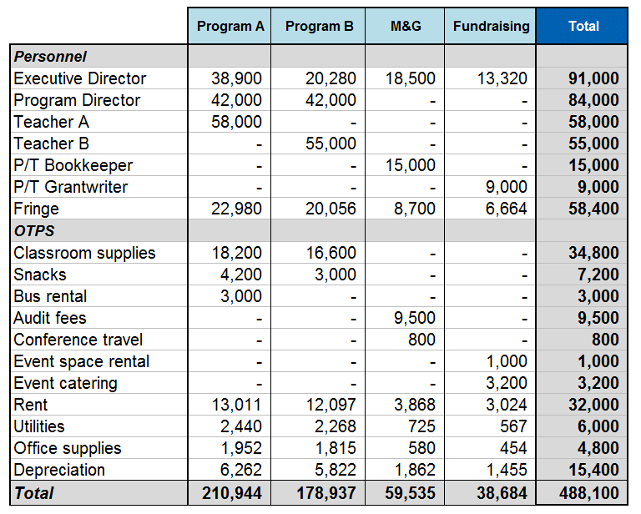
Bringing Together
Tiers 1, 2 and 3
TIER 1:
Specific Program Expense
TIER 2:
Shared
Costs Allocated to Programs
TIER 3:
“Overhead”
Costs funded by indirect rate from program grant(s) or unrestricted revenue
Costs funded by
program grant(s)

Slide 31
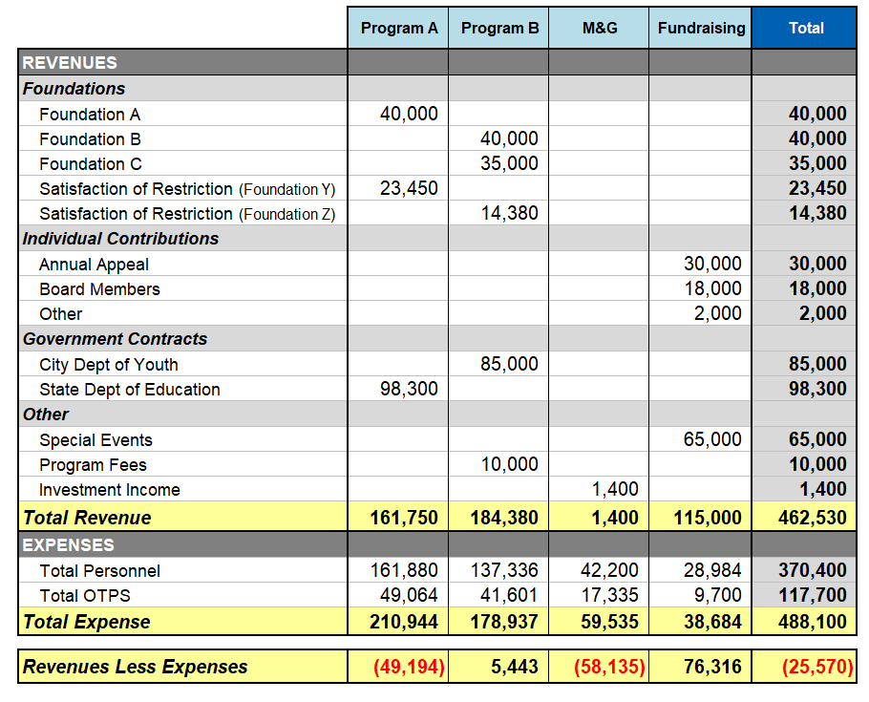
Revenue and Expenses by Program
Surplus/Deficit
By Program

Slide 32
Strategies for Funding “Tier 3” Costs
Raise unrestricted dollars
1
Develop an earned revenue stream that covers the true cost of the associated program
2
Indirect cost recovery (i.e. building an indirect cost rate into requests for restricted program funds)
Indirect cost recovery (i.e. building an indirect cost rate into requests for restricted program funds)
3
3

Slide 33
The True Cost Project: A Study of Indirect Cost

Slide 34
Poll: Do you have a maximum indirect cost rate for project grants? If so, what is the rate?
1 | 10% or less
2 | Between 11% and 15%
3 | Between 15% and 20%
4 | Over 20%
5 | We fund indirect costs at their actual rate, as provided by the grantee
6 | N/A: we don’t make project grants

Slide 35





True Cost Project
Partnership between 5 foundations working to develop a shared, scalable solution to insufficient indirect cost recovery among nonprofits.

Slide 36
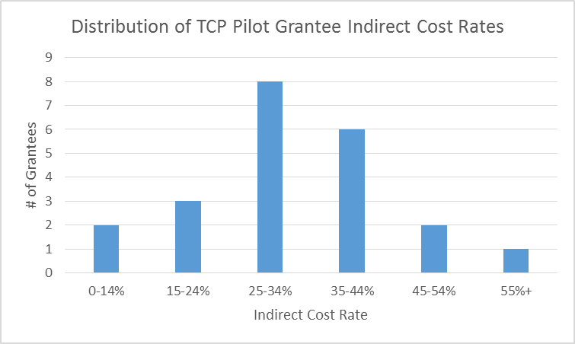
True Cost Project: Key Findings & Takeaways

Slide 37
True Cost Project: Sector Level Implications
Average “verified”
IDC rate calculated in the pilot
Average
IDC rate calculated using data in audits / 990s
Common funder cap for IDC in project grants
34%
24%
10% - 20%

Slide 38
Financial
Resilience

Slide 39
Financial Resilience
Values
Practices
Resources

Slide 40
Supporting Financial Resilience
Potential Ways to Support Your Grantees:
  Fund the true cost of programs you support
  Provide unrestricted grants
  Provide multi-year grants
  Provide capital for change and security
  Invest in infrastructure
  Fund capacity building

Slide 41
Thoughts &
Questions

Slide 42
Resources & Wrap Up

Slide 43
Up Next: Part 3
Session 3: Reframing Your Financial Due Diligence Process
April 23, 10:00am to 11:30am
Homework: reflect on the following questions
What financial documents do you collect from grantees?
At which points in the grant cycle do you collect them?
Is the same level of financial due diligence conducted for every grant type? Every organization type?
How has your due diligence process changed given current circumstances? Are those changes permanent or temporary?
Notes:
How did the grantmaking framework changed?
Do Jennifer and Rodney have a good set of questions?
Do a breakout on this in session three – but keep the poll here

Slide 44
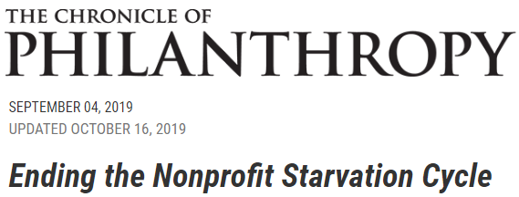
Resources: True Cost
  Five Foundations Address the “Starvation Cycle”
  The Best Solutions Have a Compelling Story Behind Them
  The Price of Real Change
  How Foundations and Nonprofits Can End the ‘‘Starvation Cycle’’
  How One Nonprofit Prepared for Tough Conversations With Funders
  Why Funders Should Pay for the True Costs of Nonprofits’ Work
  Five Nonprofit Survival Skills for Managing Low-Overhead Funding
  Learning Strategic Financial Management From the School of Hard Knocks

Slide 45

Resources: True Cost
Revised Indirect Cost Rate Policy
rwjf.org/content/granteeresources/legal-and-policy/Indirect_Cost_Rate.html
A Step Toward Supporting the True Cost of Nonprofits’ Work
hewlett.org/a-step-toward-supporting-the-true-cost-of-nonprofits-work
Changing How We Support Indirect Costs
macfound.org/press/perspectives/changing-how-we-support-indirect-costs/

Slide 46

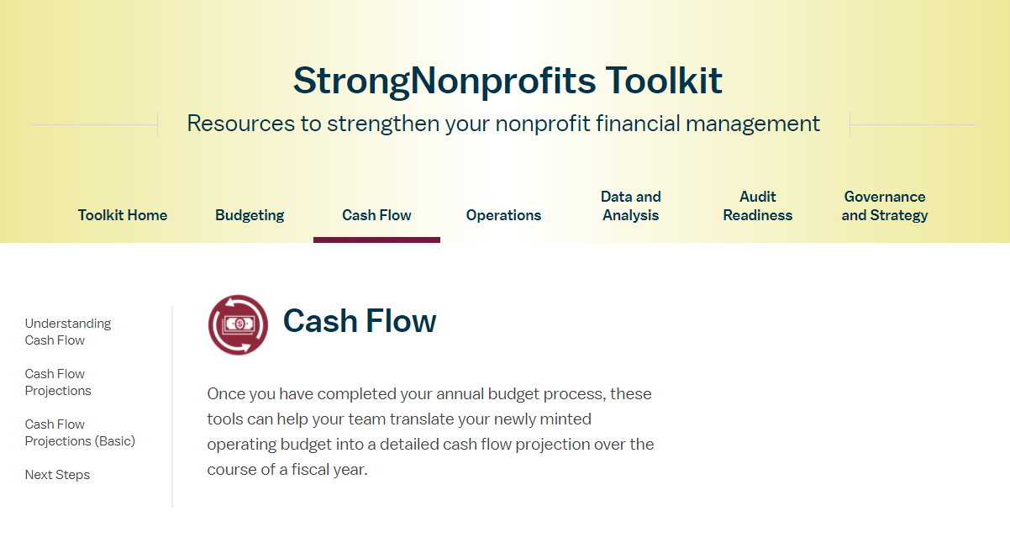
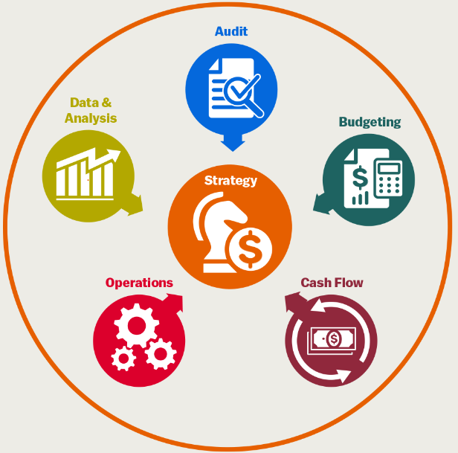

Resources for Your Grantees
In collaboration with the Wallace Foundation, FMA created a library
of free tools and resources to help organizations become “fiscally fit”.
www.strongnonprofits.org
Notes:
FY21 Dates
September 8
November 10
January 19
March 23
May 18

Slide 47

StrongNonprofits.org
  Online Tutorials for
  StrongNonprofits.org
  Complimentary one-hour orientation webinars that feature an overview of the website and drill down on some of its key resources
  To register and see upcoming webinar dates:
  fmaonline.net
Upcoming webinar:
May 18, 2021
2pm (Eastern)
Notes:
FY21 Dates
September 8
November 10
January 19
March 23
May 18

Slide 48


About BDO FMA
BDO FMA exists to build a community of individuals with the confidence and skills to lead organizations that change the world.
  Established in 1999 to serve not-for-profit organizations around the country — combined with BDO in 2021
  Provides customized financial management, accounting, software, organizational development, and other consulting services
  Works directly with organizations or through funder-supported management and technical assistance programs
@FMA4Nonprofits
fmaonline.net/linkedin
New York/Chicago/Oakland/Providence/Washington DC
www.fmaonline.net

