Slide 1
Philanthropy’s Role in Reparations: Building a Culture of Repair
February 14, 2024

Slide 2
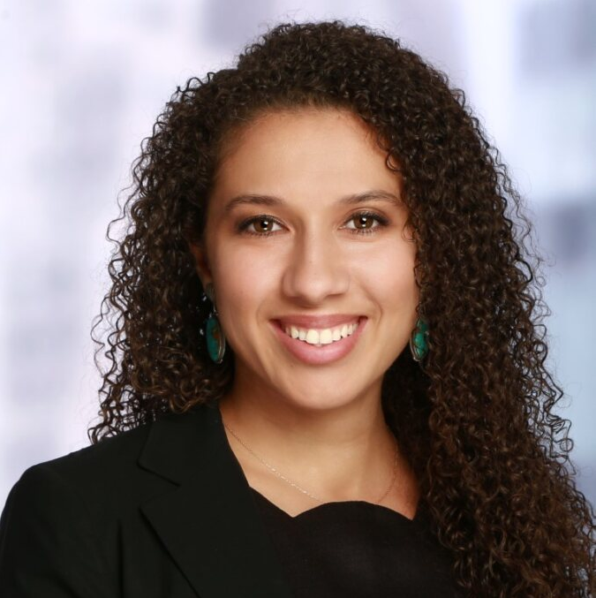
Introductions
Lyell Sakaue
Aria Florant
Partner The Bridgespan Group
Co-Founder & Managing Director Liberation Ventures

Slide 3
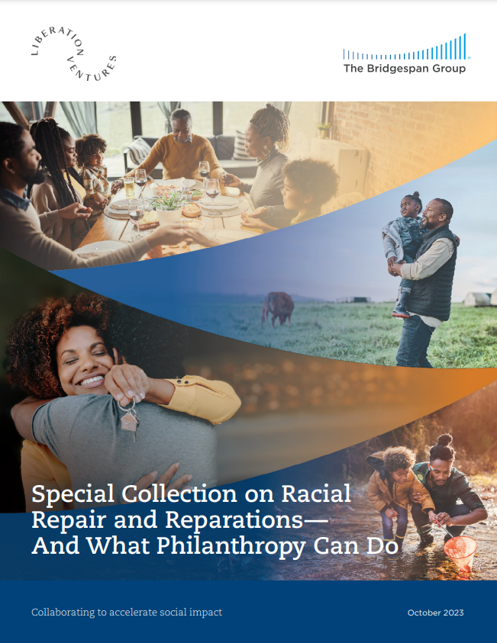
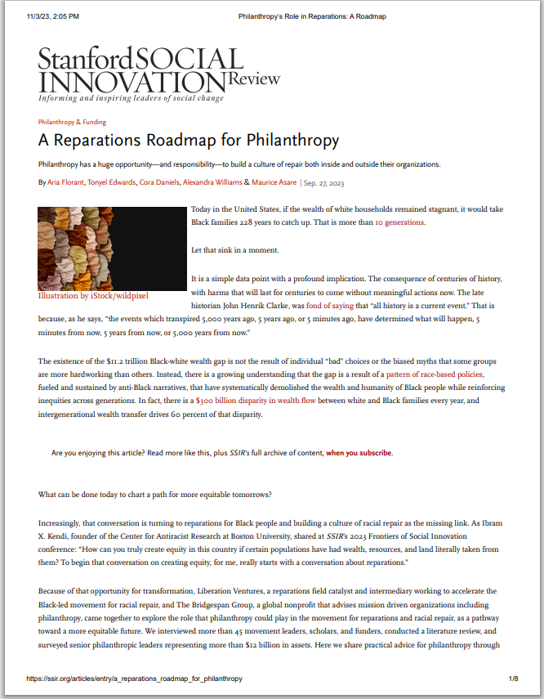
Bridgespan and Liberation Ventures co-authored two articles on philanthropy’s role in reparations
“Philanthropy’s Role in Reparations and Building a Culture of Racial Repair” (Bridgespan.org, October 2023)
“A Reparations Roadmap for Philanthropy”
(Stanford Social Innovation Review, October 2023)

Slide 4
The Bridgespan Group is a global nonprofit that advises mission-driven leaders, organizations, and funders, to make the world more equitable and just.
The “north star” for our work with philanthropists is to increase the amount of funding flowing in support of high- impact social change efforts aimed toward equity and justice
Without a deliberate emphasis on racial equity (among multiple dimensions of inequity), U.S. funders are leaving impact on the table
“The opportunity is here, the opportunity is now. You can either be on the cutting edge to make transformational change happen or regret not doing so later.” -- Nkechi Taifa, Reparation Education Project
Source: Bridgespan Research

Slide 5
Liberation Ventures is a field catalyst working to accelerate the movement for Black-led racial repair in the US
Our North Star is to see comprehensive federal reparations.
We mobilize resources, support movement partners to build their capacity, build narrative power, and organize donors.
In the last three years we have moved ~$6.5M to the field.

Slide 6
Why reparations?
Government policies have enabled white wealth to compound while extracting black wealth

Slide 7
If white wealth were to remain stagnant…
WHITE WEALTH
…it would take Black families 228 years to catch up
WEALTH GAP
BLACK WEALTH
YEARS
20
40
60
80
100
120
140
160
180
200
220
Source: Institute for Policy Studies https://ips-dc.org/report-ever-growing-gap/

Slide 8
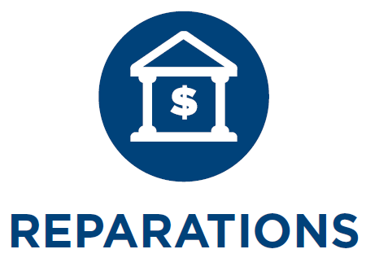
Imagine a nation where the racial wealth gap narrows and we all enjoy the power of a multiracial democracy
ACHIEVING REPARATIONS
 | DEFINITION | EXAMPLE INVESTMENTS
 | A federal program designed to narrow the Black-white wealth gap and engage in the pillars of building a culture of repair | Convening and planning support to design a coordinated movement strategy Narrative change to build public understanding on reparations Research to inform reparations program design Lobbying efforts Grassroots organizing to mobilize constituencies
BUILDING A CULTURE OF RACIAL REPAIR
 | Understanding and grappling with the what, how, and why of actions that have contributed to harm | Storytellers, artists, journalists, and scholars creating new ways to unearth and understand racial injustice Commissions for wealth-origin research and stories for institutions, corporations, and families Educators and organizations designing curricula that teach truthful US history Initiatives for open dialogue and advancing racial healing Movement leaders and efforts pushing back on the anti-critical race theory movement Creation of and increased access to programming in public memorials, museums, and other institutions that serve to acknowledge harm
 | Admission that harm has been done
 | Ownership and willingness to take responsibility for harmful actions and commit to non-repetition | Black community land trusts, community investment trusts, and worker cooperatives to rebuild land ownership and economic self-determination Large, unrestricted grants or endowments to Black-led organizations and institutions to enable greater levels of self-determination Efforts to help Black families and communities reclaim wrongfully stolen assets and land Funding staff position(s) and research efforts for local and state initiatives and reparations commissions to explore and create redress for specific, historic harms Pilot programs in guaranteed income, baby bonds, and other asset-building initiatives for and with Black communities Debt relief for Black farmers and broader efforts to direct federal funding resulting from recent policies to Black-led and Black-serving organizations and institutions
 | Acts of restitution, compensation, and rehabilitation; proactive steps taken to embed racial justice into systems and “heal the wound”
Intangible investments | Convene conversations on reparations internally with board and with peer funders and other stakeholders; elevate topic of reparations externally and among peers; ensure Black and grantee representation in decision-making bodies on Board and in organizational leadership.
(NOTE: This is not an exhaustive list of reparations and repair investments. These are ideas from conversations with movement leaders meant to showcase the breadth of potential opportunities.) Source: The Bridgespan Group; adapted from Liberation Ventures “Why Reparations”

Slide 9
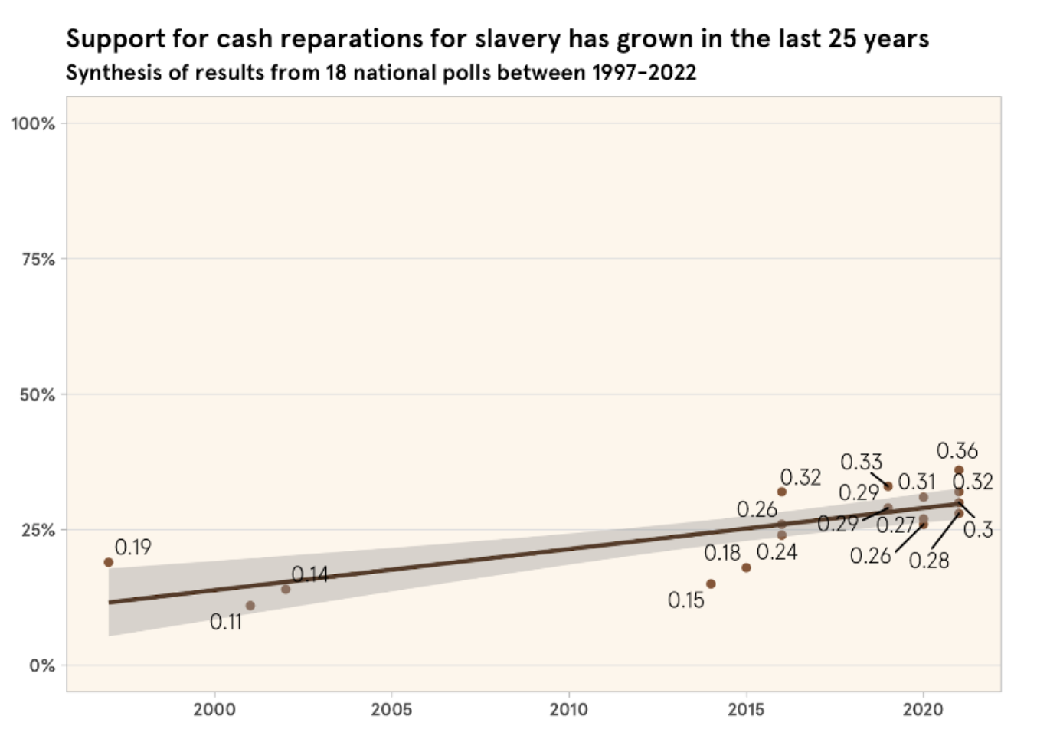
Momentum for reparations is growing, but it will require a long-term coordinated effort to withstand opposition
Source: Liberation Ventures, “Reparations polling roundup: the last 25 years”

Slide 10
We identified three key roles for philanthropy to play in the movement for reparations and building a culture of repair
1
Live into a culture of racial repair in your own institution
Resource the reparations and repair ecosystem. It may require considering how to integrate the reparations ecosystem into existing portfolios, into place-based strategies, and into designing new portfolios or initiatives.
2
Increase the use of Black asset managers and Black-owned investment firms. Shifting endowments to mission-related investments will benefit Black communities and contribute to racial repair.
3

Slide 11
Repair is possible and now is the time to resource the ecosystem
Source: The Bridgespan Group; Adapted from Liberation Ventures, “Why Reparations?”

Slide 12
Key takeaways
Reparations is more than an overdue paycheck, but also about creating and sustaining a culture of racial repair
There is a role for philanthropy in reparations
Live into a culture of repair within your own institutions
Resource the reparations ecosystem
Ensure your endowment is mission-aligned and shift resource management to Black-led firms and Black investment managers
The bigger risk is staying on the sidelines, especially at a time when powerful movements are underway to erase Black history

Slide 13
overall_0_132890683543515110 columns_1_132890673013020096
Stay Connected:
Publications@Bridgespan.org
www.Bspan.org/subscribe
@BridgespanGroup

